Slide 1
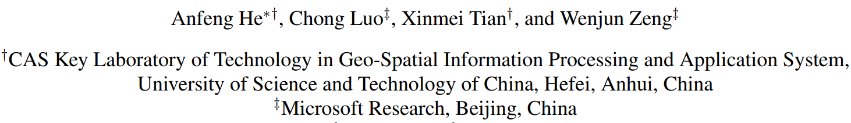
A Twofold Siamese Network for Real-Time Object Tracking
Published in CVPR- 2018
Presented by:
Md. Maklachur Rahman School of Computer Science and Engineering
Kyungpook National University
Republic of Korea

Slide 2
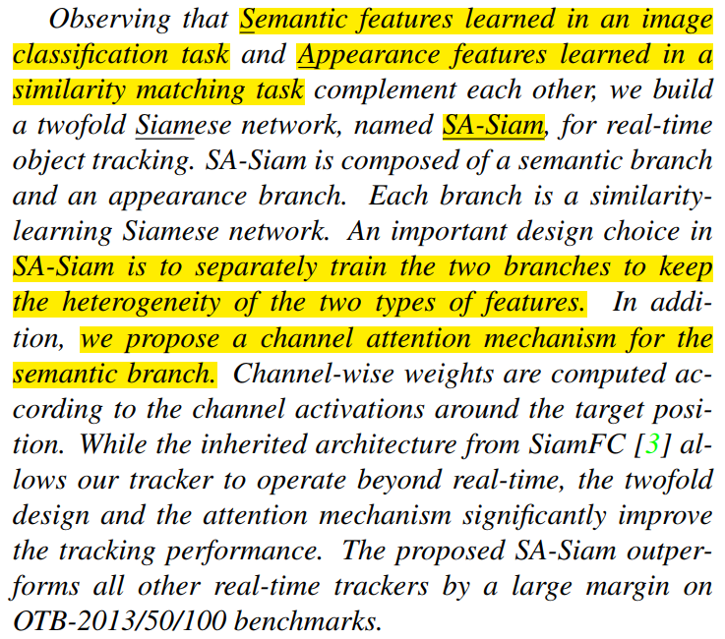
Abstract
In this paper, they introduce twofold Siamese networks, one is Semantic branch and the other is the Appearance branch combinedly named SA-Siam.
Semantic features learned in an image classification task and Appearance features learned in a similarity matching task.
An important design choice in SA-Siam is to separately train the two branches to keep the heterogeneity of the types of features.
The proposed tracker showed good performance over OTB-2013/50/100 benchmarks.

Slide 3
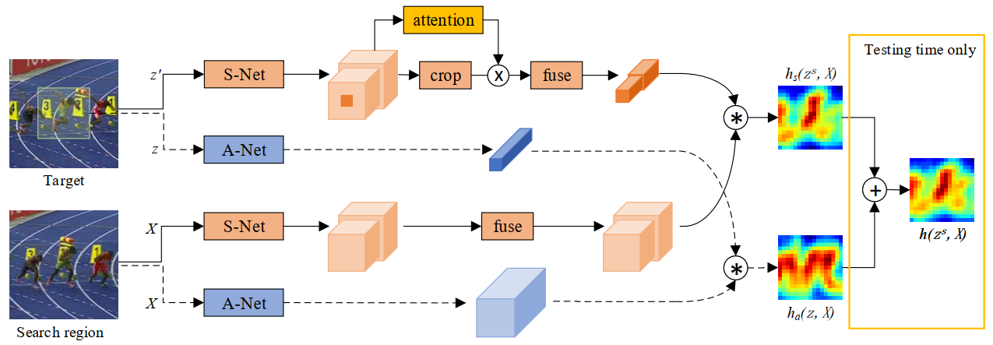
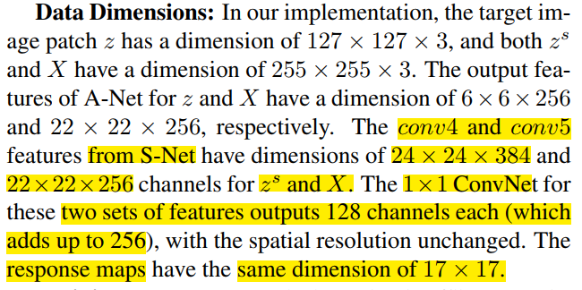
Tracker architecture

Slide 4
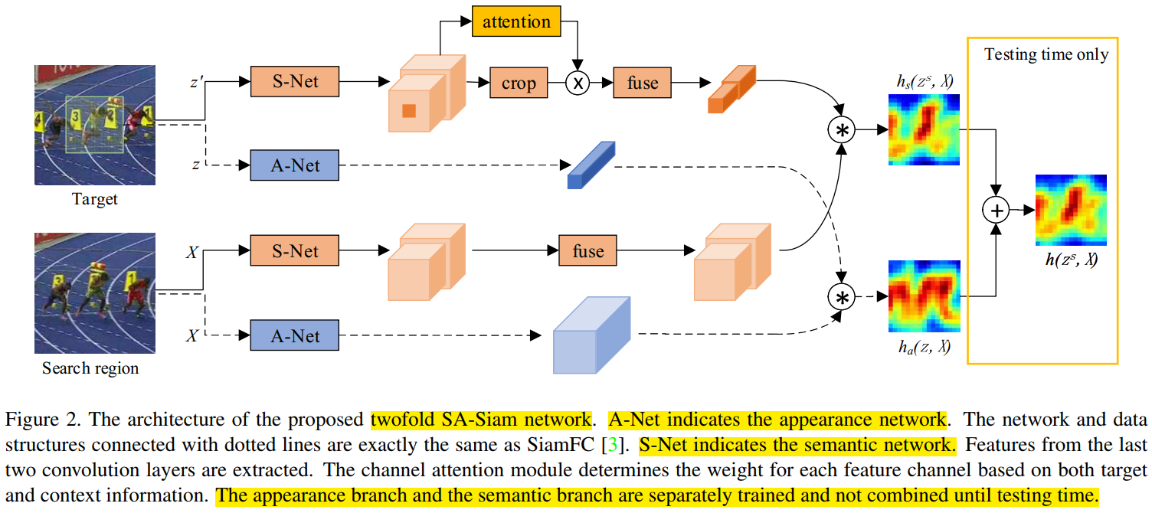
Tracker architecture
The appearance branch (A-Net) takes (z, X) as input. It clones the SiamFC network and calculated as
The semantic branch (S-Net) takes (z^{s} , X) as input where, z^{s} has z in its center and contains the context information of the target. It is calculated as

Slide 5
Design Selection
Why Conv4 and Conv5 layer features are taken for S-Net?
Because the high-level features focus on semantics, while the low-level features retain more accurate position information, the two can complement each other.
Why channel attention added to the S-Net?
High-level semantic features are very robust to the deformation and rotation of the object, but they result in low discriminative power.
In order to increase the discriminative power of semantic features, the author designed the channel attention module.
Channel attention is used to improve the discrimination ability of the network.

Slide 6
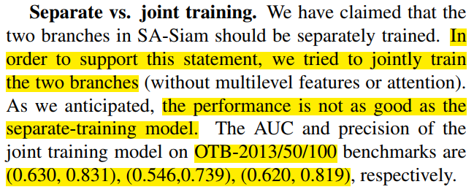
Separate VS Joint training
The performance is not as good as the separate-training model.
The AUC and precision of the joint training model on OTB-2013/50/100 benchmarks are (0.630, 0.831), (0.546,0.739), (0.620, 0.819),

Slide 7
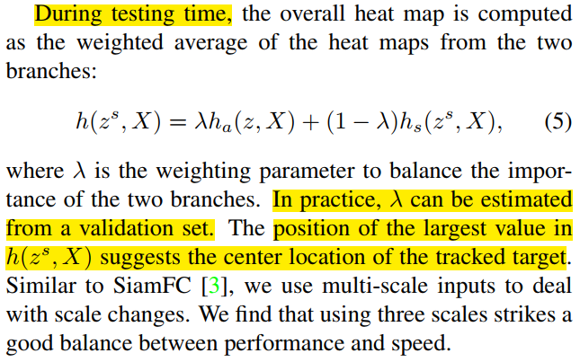
Testing

Slide 8
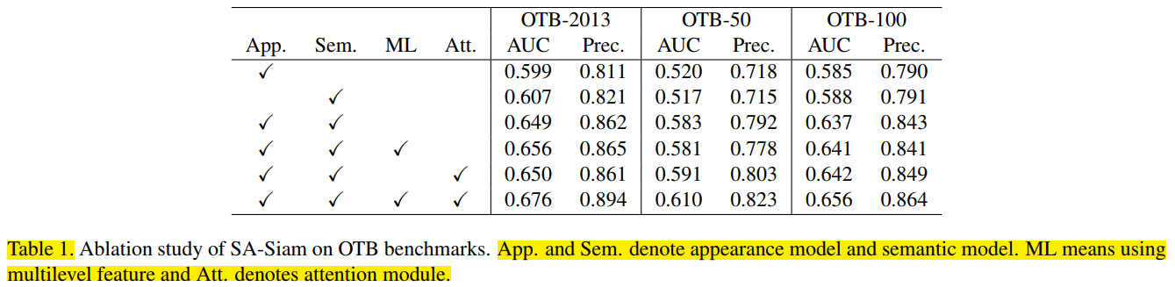
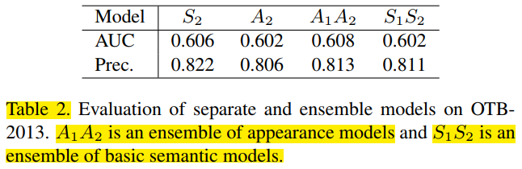
Ablation results on OTB13 dataset
Evaluate the performances of the semantic model alone ( called model S₁ ).
Evaluate the performances of the appearance model alone (called model A₁ ).
The semantic branch and the appearance branch complement to each other.

Slide 9
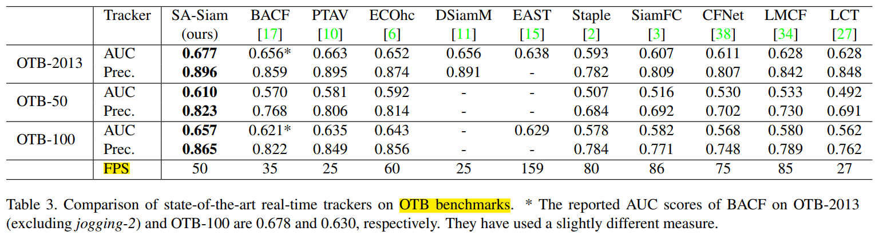
Experimental results on OTB benchmarks

Slide 10
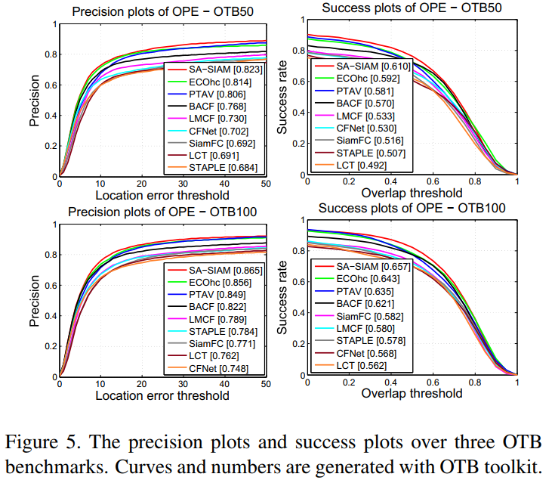
Experimental results on OTB50 and OTB100

Slide 11
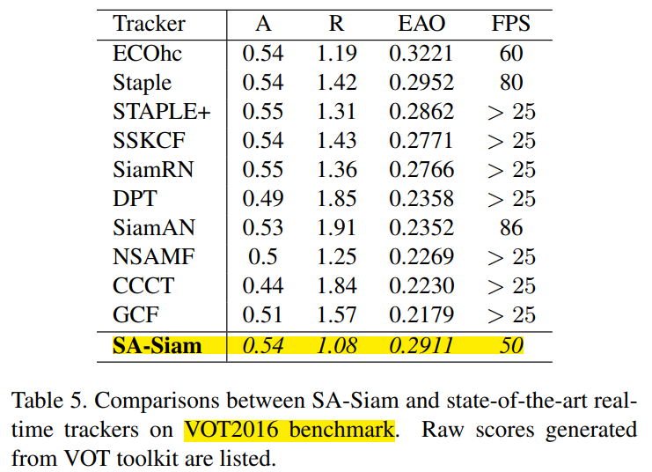
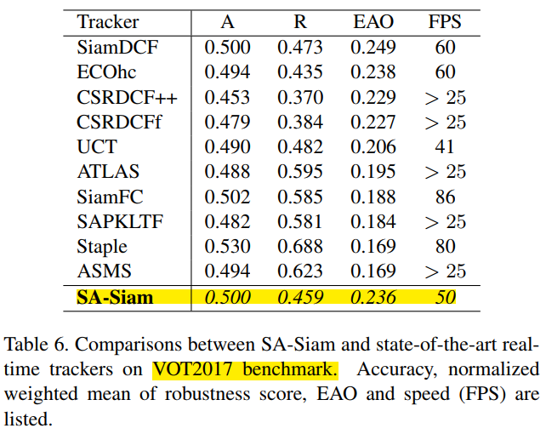
Experimental results on VOT dataset

Slide 12
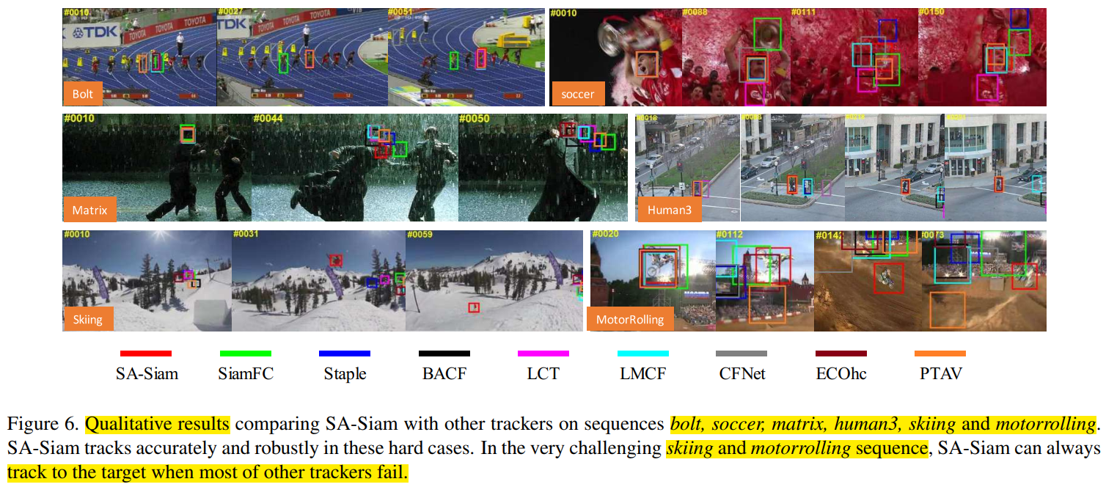
Qualitative results comparing for SA-Siam

Slide 13
Conclusion
In this work, they use complementary semantic features and appearance features together.
The resulting tracker greatly benefits from the heterogeneity of the two branches.
The proposed SA-Siam outperforms other real-time trackers by a large margin on the OTB benchmarks.

Slide 14
감사합니다 (Thank you) Q&A

